Slide 1

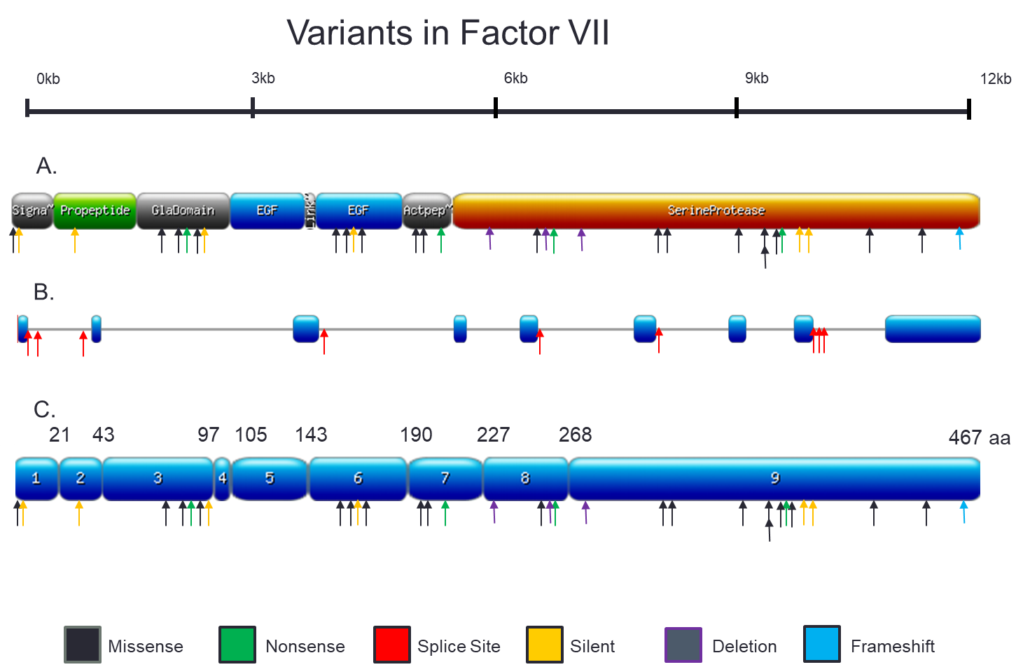
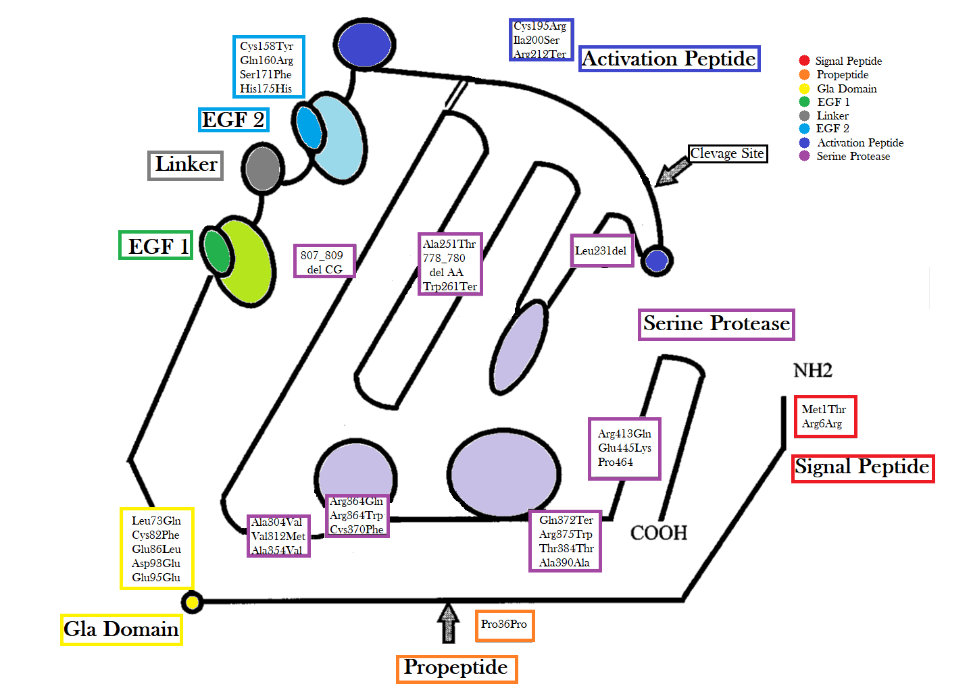
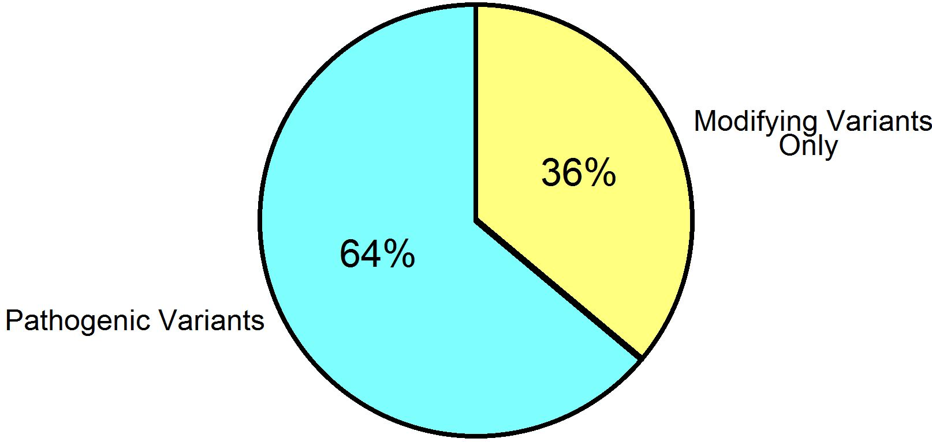
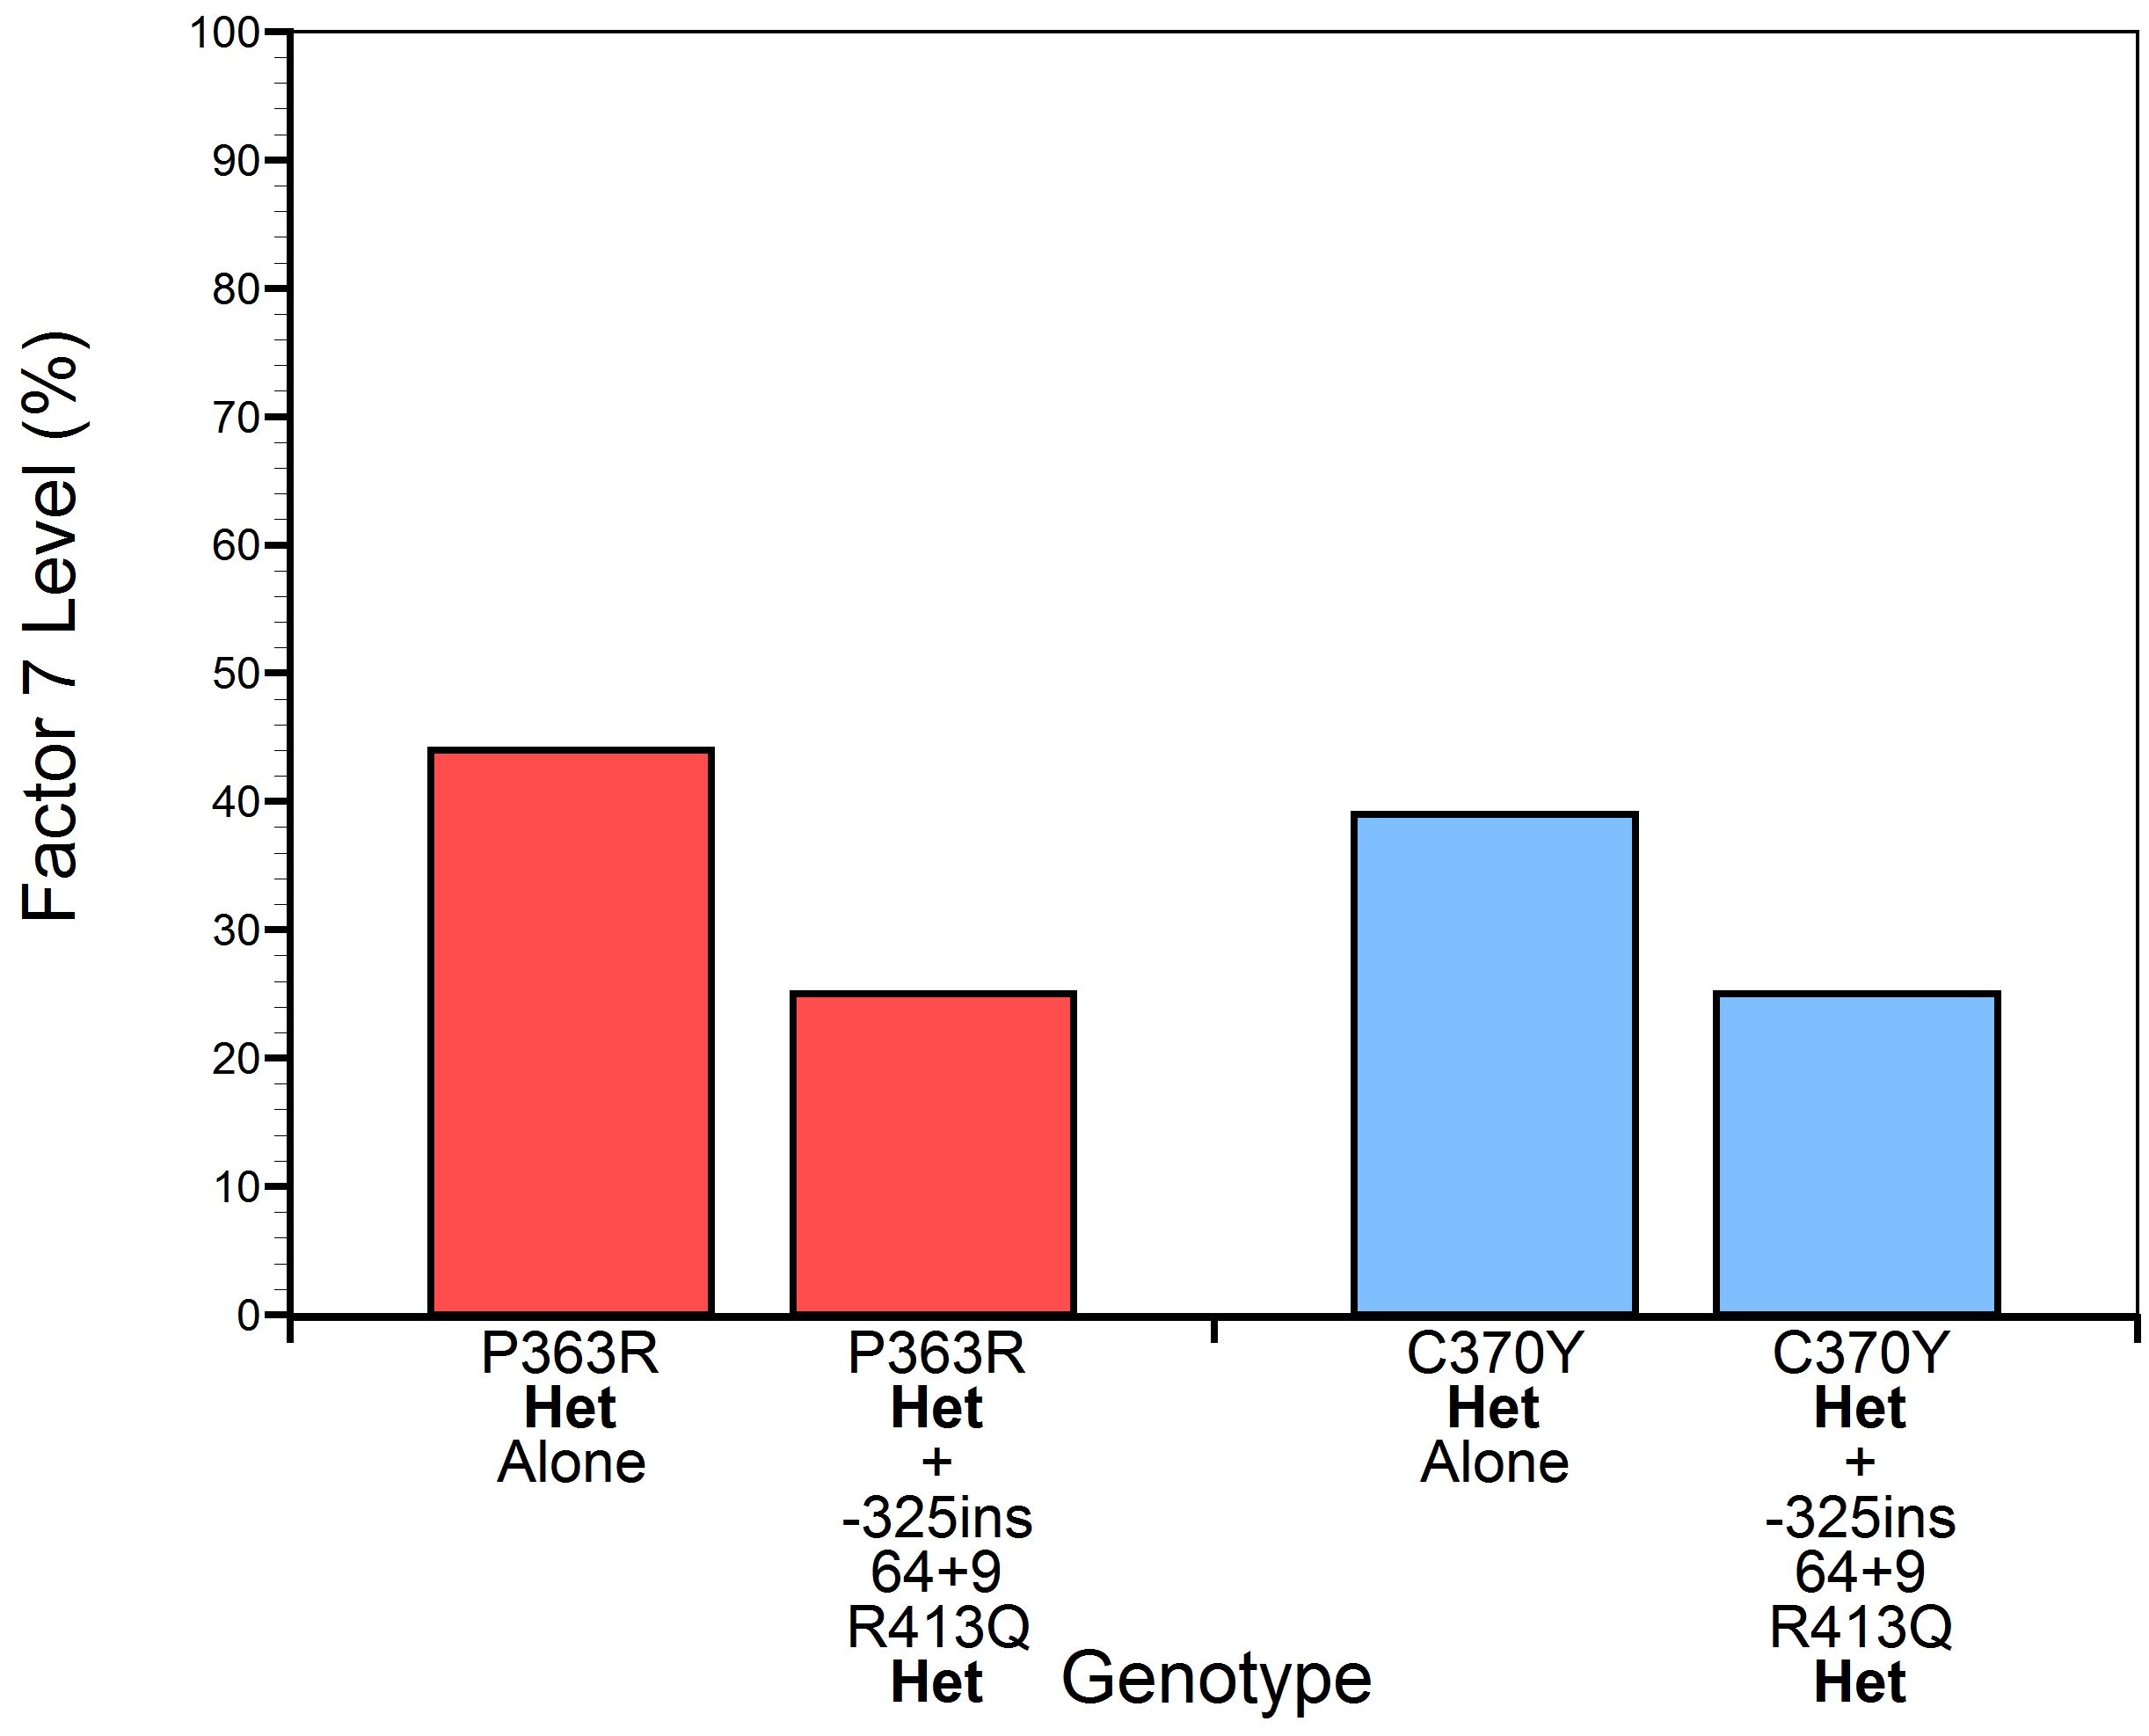
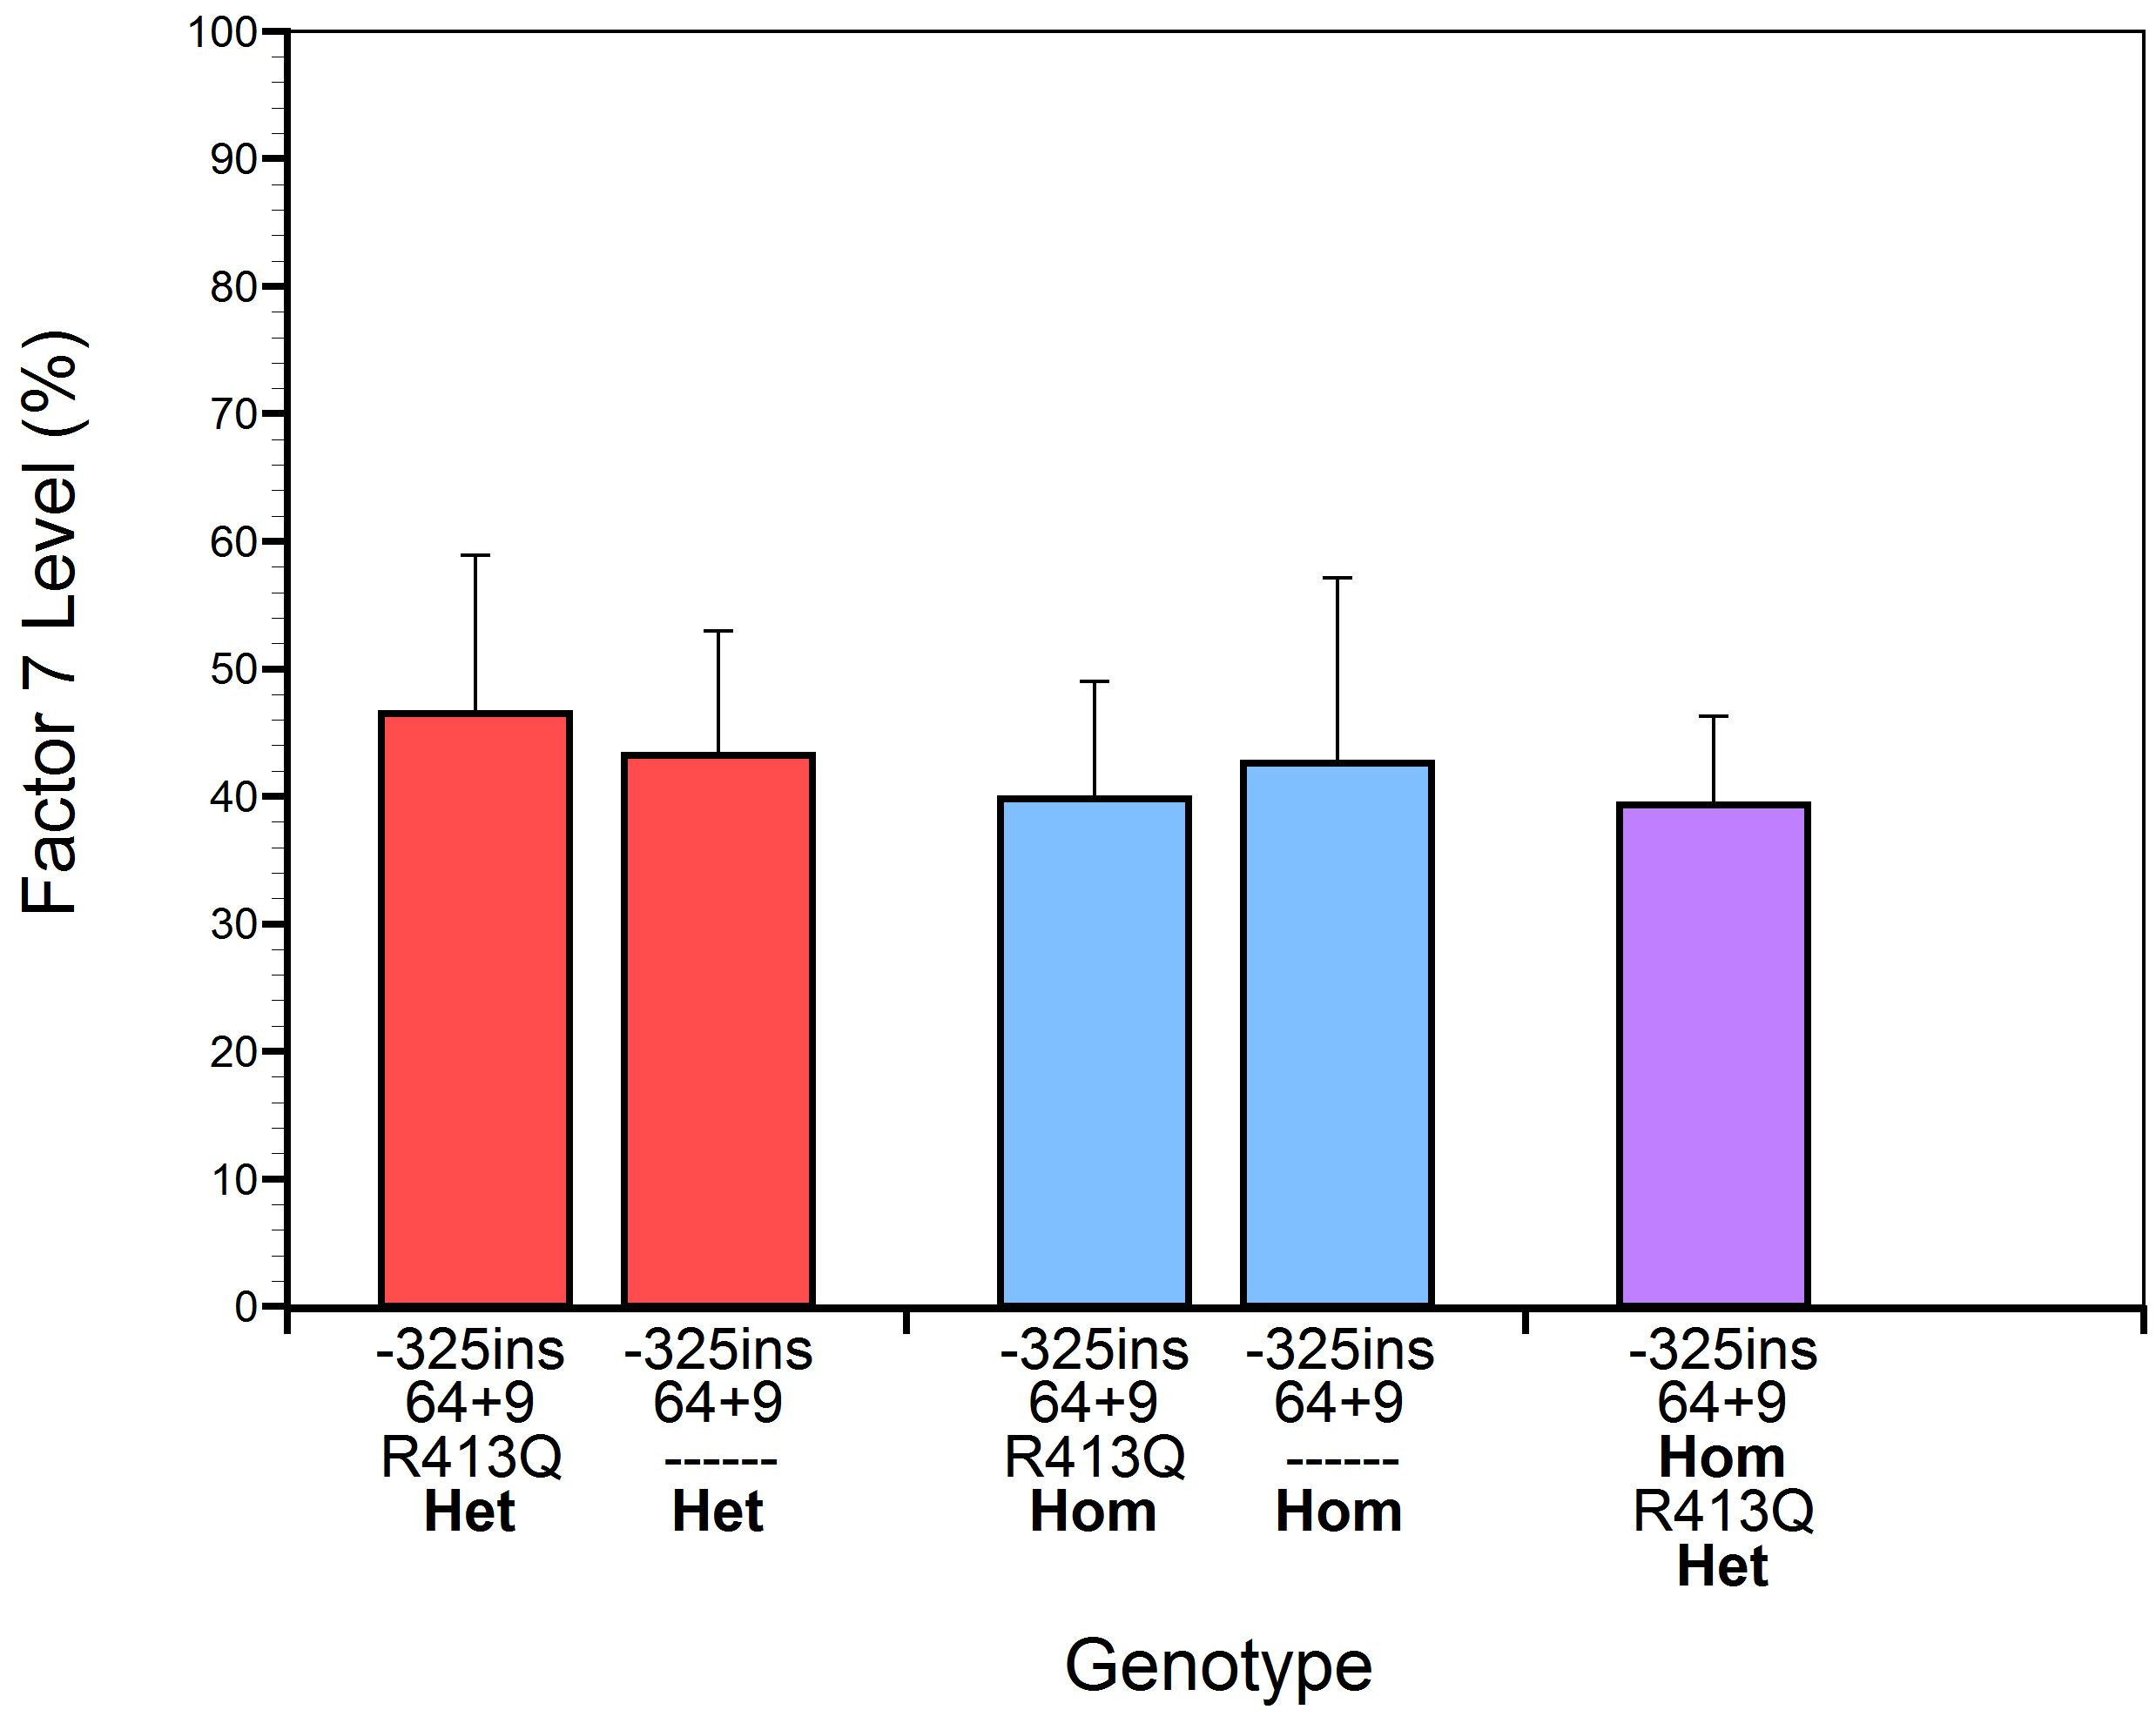
PB1333
Modifying variants that alone are sufficient to reduce FVII levels
D. Nugent^{1,2}, S. Williams², C. Ashburner¹, N. Crook¹, M. Chandler³, T. Singleton^{3,4}, S. Acharya⁵ and A. Shapiro⁶
1 Center for Inherited Blood Disorders, Orange, CA, United States; 2 Hematology Advanced Diagnostic Laboratory, CHOC Children’s Hospital and UC Irvine, Orange, CA, United States; 3 American Thrombosis and Hemostasis Network, Hickory, NC, United States; 4 Ochsner Clinic Foundation, New Orleans, LA, United States; 5 Northwell Health, Cohen Children’s Medical Center, New Hyde Park, NY, United States; 6 Indiana Hemophilia & Thrombosis Center, Indianapolis, IN, United States
Introduction
Factor VII deficiency is a rare coagulation disorder that varies in severity among affected individuals. It is estimated to affect 1 in 300,000 to 1 in 500,000 people. However, up to one-third of people with factor VII deficiency have not reported bleeding events. The severity of factor VII deficiency can vary greatly from one person to another and also varies based upon the residual measured FVII level.
Results
Conclusions
Modifying, common variants in F7 have been found to decrease FVII levels, when found in combination with either pathogenic or likely pathogenic variants. In our cohort, these modifying variants are found by themselves, without a pathogenic or likely pathogenic variant, in 36% of the individuals with a primary diagnosis of FVII deficiency. The FVII levels of these individuals with only modifying variants range between 15% and 68% of normal. This level of reduction is in the range of most pathogenic variants. Modifying variants, which can reduce factor levels exclusively, should be an exception to the benign criterion of BA1 where if the minor allele frequency is less than 0.05 the variant is considered benign. Our findings strengthen the growing body of evidence that modifying variants, especially the promoter -325 10 bp insertion found in 100% of our modifying variant only subset, need to be reclassified to reflect their ability to reduce FVII levels independently.
Frequency ≠ benign
Schematic of Factor VII Protein
AIM
To better understand the nature of FVII deficiency in the US and the variants involved, we used a subset of participants from the American Thrombosis and Hemostasis Network study ATHN 10: Leveraging the ATHNdataset to Document the State of Rare Coagulation Disorders in the US, who were diagnosed with FVII deficiency, to analyze after performing whole gene sequencing.
Modifying Common Variants of Factor 7
Genetic Causation of Factor VII Deficiency in ATHN10 Cohort
MethodS
Individuals with an established rare coagulation disorder receiving care at an HTC provided informed consent for enrollment, data collection, and genetic testing.
A single EDTA tube of blood was collected from each participant and DNA was isolated from blood samples collected. Next-Generation sequencing (NGS) was performed on a NextSeq instrument (Illumina) to a read depth of >50 by PacificDx. Whole gene sequencing (exons, introns, and 1500 nucleotides both up and down stream) for thirty one genes (including Tissue Factor) known to cause an ultra-rare factor deficiency, platelet dysfunction, thrombocytopenia, and thrombophilia diagnoses included in the project was performed for each participant. This next-generation sequencing (NGS) panel captured not only missense variants but was also highly effective in detecting large deletions, splice site variants, copy number variants, and early stop codon mutations.
Disease Demographics:
36% of total participants (474/1300) had a primary diagnosis of a FVII deficiency.
      22% had a pathogenic variant alone
      42% had a pathogenic variant + modifying variants
      36% modifying variants alone
      <1% had no detected variants (levels between 30 and 54%). No detected Tissue Factor variants either.
18% of total participants had a different primary rare coagulation disorder diagnosis but were incidentally found to have a F7 variant.
6% of participants with a diagnosis of FVII deficiency had a novel variant.
Modifying Common Variants Further Reduce Factor VII Levels in Families with a Likely Pathogenic Variant
Modifying Common Variants Alone Result in Factor VII Deficiency
References
Alesci, Rosa Sonja, et al. "Utility of ACMG classification to support interpretation of molecular genetic test results in patients with factor VII deficiency." Frontiers in Medicine 10 (2023): 1220813.
Ghosh, Rajarshi, et al. "Updated recommendation for the benign stand‐alone ACMG/AMP criterion." Human mutation 39.11 (2018): 1525-1530.
Giansily‐Blaizot, Muriel, et al. "The EAHAD blood coagulation factor VII variant database." Human Mutation 41.7 (2020): 1209-1219.
*
*
*
*
Acknowledgements
Thank you to ATHN, Indiana Hemophilia & Thrombosis Center, Center for Inherited Blood Disorders and Novo Nordisk for funding this project. Thank you to all HTCs that have enrolled participants in this project and the patients who have allowed us to collect these specimens and data. Thank you to Jeff Buzby PhD, Hilary Summer Markoe, and Shelby Domino for their work on creating this poster.
*
Data presented as mean ± SD.
*p<0.05 vs.100%

