Slide 1

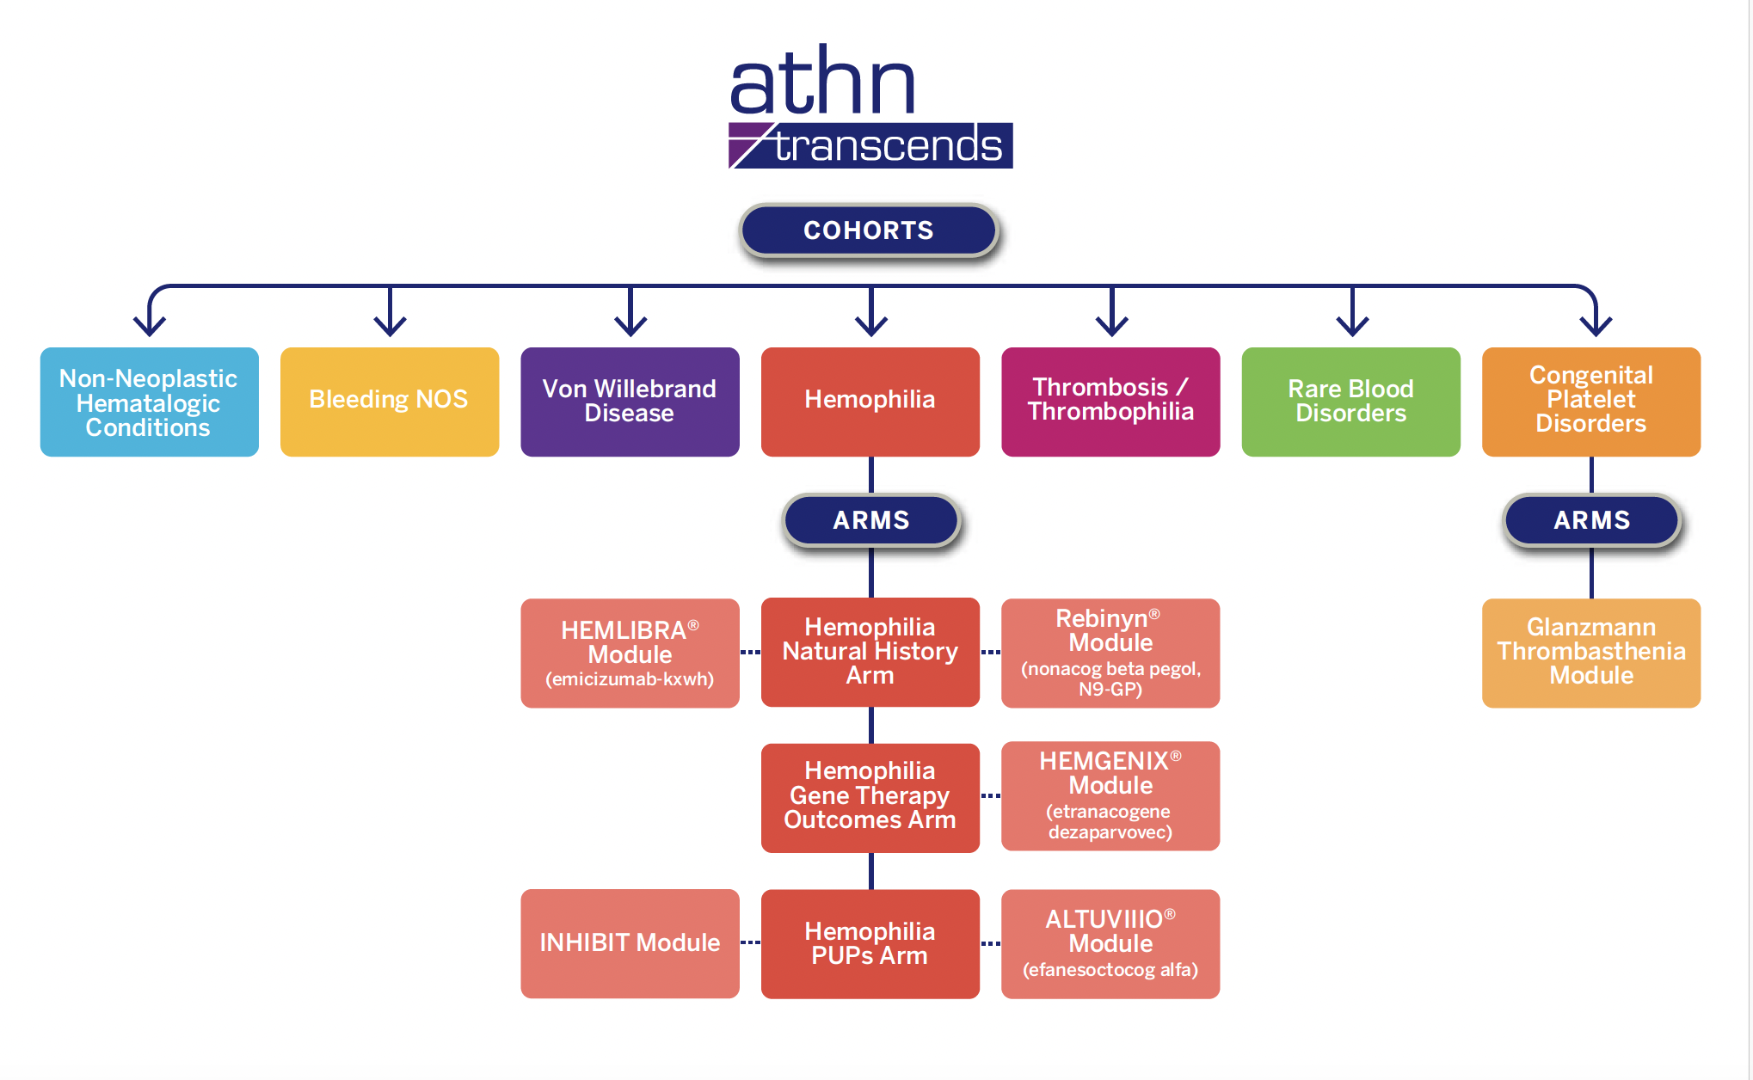


ATHN Transcends INHIBIT Module – Prospective Study of Inhibitors and Biomarkers in Previously Untreated Hemophilia A Patients
N. MACHIN^{1,2}, M. RAGNI^{1,2}; T. CHRISENTERY-SINGLETON^{3,4}; J. SCHWARTZ³ and K. PRATT⁵.
1. University of Pittsburgh, PA, USA; 2. Hemophilia Center of Western Pennsylvania, PA, USA; 3. American Thrombosis and Hemostasis Network, NC, USA; 4. Ochsner Clinic Foundation, LA, USA; 5. Department of Medicine, Uniformed Services University of the Health Sciences, MD, USA.
Introduction
Inhibitor development remains the most serious complication of hemophilia A treatment.
The current incidence in the era of emicizumab and early factor VIII (FVIII) prophylaxis is unknown.
Biomarkers to predict inhibitor development could guide future individualized care.
Results
Study Activation
  IRB approval obtained; the study is active and enrolling
  35 ATHN-affiliated sites identified
  13 sites fully activated
  Target: 40 enrolling sites nationwide
Enrollment Target
  Goal to enroll 150 previously untreated patients with severe hemophilia A
Current Milestones
  Centralized biospecimen collection and testing infrastructure in place
  Enrollment underway at high-volume pediatric HTCs
  Early participation reflects broad institutional representation and geographic diversity across the U.S.
AIMS
Primary Objective: Describe the rate of inhibitor formation in previously untreated patients (PUPs) with severe hemophilia A.
Secondary Objective: Identify biomarkers and immune/genetic correlates of inhibitor development.
Method
5-year multicenter, observational cohort (ATHN Transcends INHIBIT Module; NCT04398628)
Population: PUPs with severe hemophilia A
Treatment groups:
    FVIII replacement
    Emicizumab ± FVIII
Assessments:
    Scheduled inhibitor testing at multiple time points and exposure days (EDs)
    Peripheral blood mononuclear cell response assays, multi-analyte plasma profiling
    Whole-genome sequencing, HLA typing
    Bleeding rates and safety outcomes
Conclusions
INHIBIT aims to define modern inhibitor incidence and uncover predictive immune/genetic factors.
Findings will inform risk stratification and support biomarker-driven treatment pathways for PUPs.
Ongoing enrollment and longitudinal biospecimen collection will enable robust translational analyses to identify relevant immune mechanisms and novel targets for early intervention to prevent or reverse inhibitor development.
Acknowledgements
Funding: This study is supported by the Health Resources and Services Administration (HRSA).
Study Infrastructure: Conducted in collaboration with the American Thrombosis and Hemostasis Network (ATHN).
We thank our research staff, data managers, principal investigators, patients, and families for their dedication and participation in the ATHN Transcends study.
Disclaimer: The opinions and assertions expressed herein are those of the authors and do not reflect the official policy or position of the Uniformed Services University of the Health Sciences or the Department of Defense
CONTACT INFORMATION
Principal Investigator: Nicoletta Machin, DO, MS
machinnc2@upmc.edu,
X: @MachinNicoletta
Hemophilia Center of Western PA
Sterling Plaza 201 N. Craig St. Suite 500
Pittsburgh, PA 15213
Subaward PI: Kathleen Pratt, PhD
kathleen.pratt@usuhs.edu
Dept. of Medicine A3063
Uniformed Services University
4301 Jones Bridge Road
Bethesda, MD 20814
The authors report no relevant conflicts of interest.
FVIII prophylaxis cohort
Sample collection
-EDs 0-20
Severe hemophilia A PUPs
Study exit
Week 48
Emicizumab +/- FVIII
cohort
Sample collection
-Weeks 0, 24, 48
-Ad Hoc for EDs
PB0296

