Slide 1

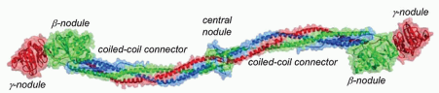
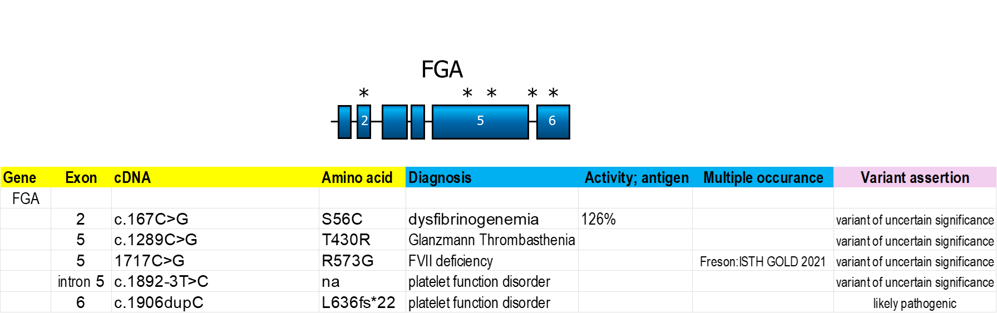
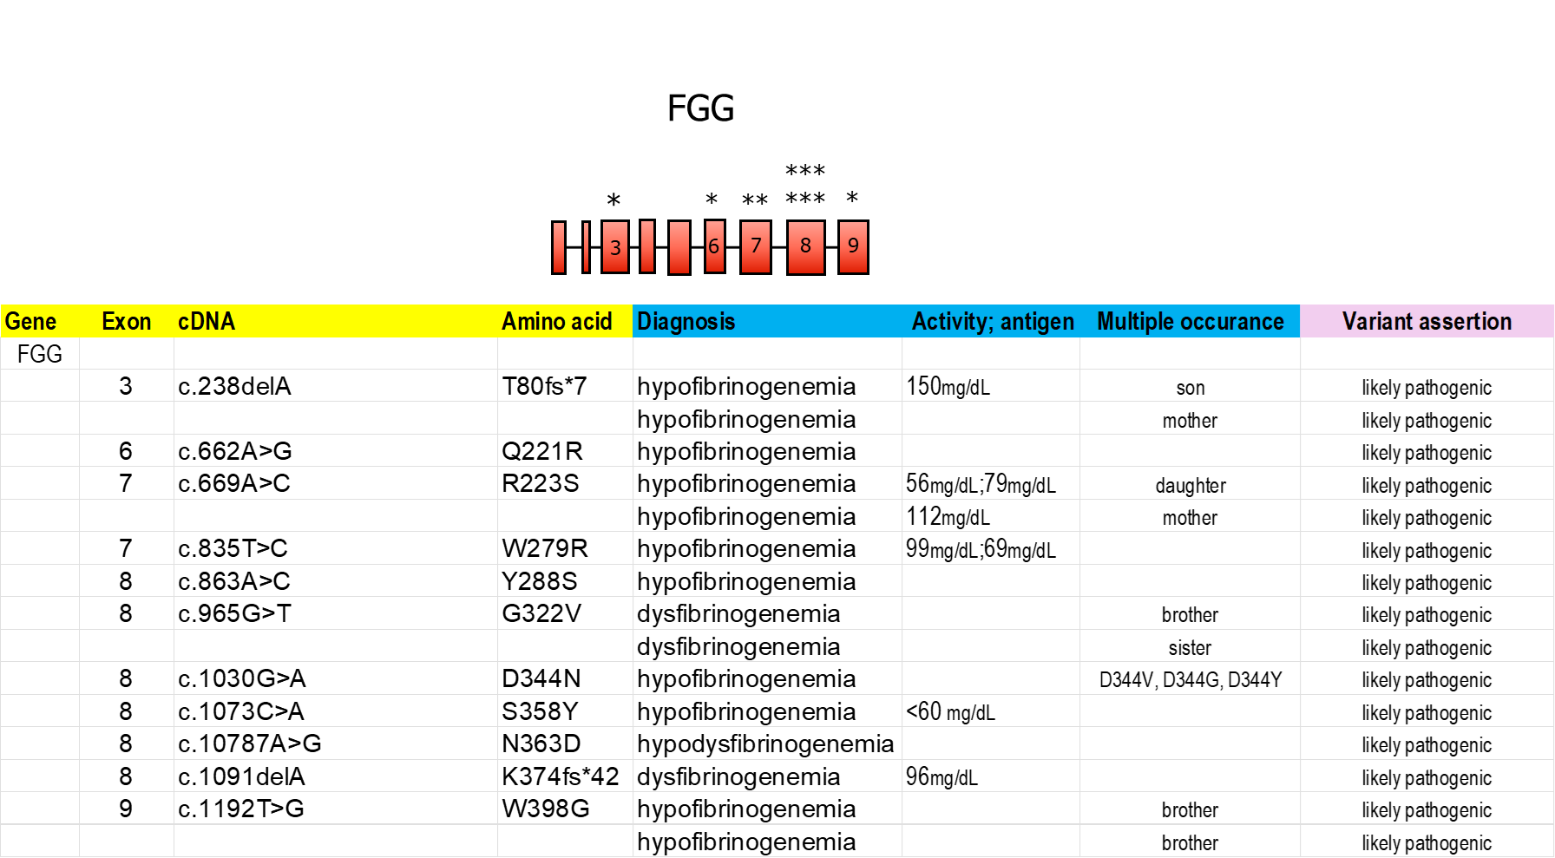
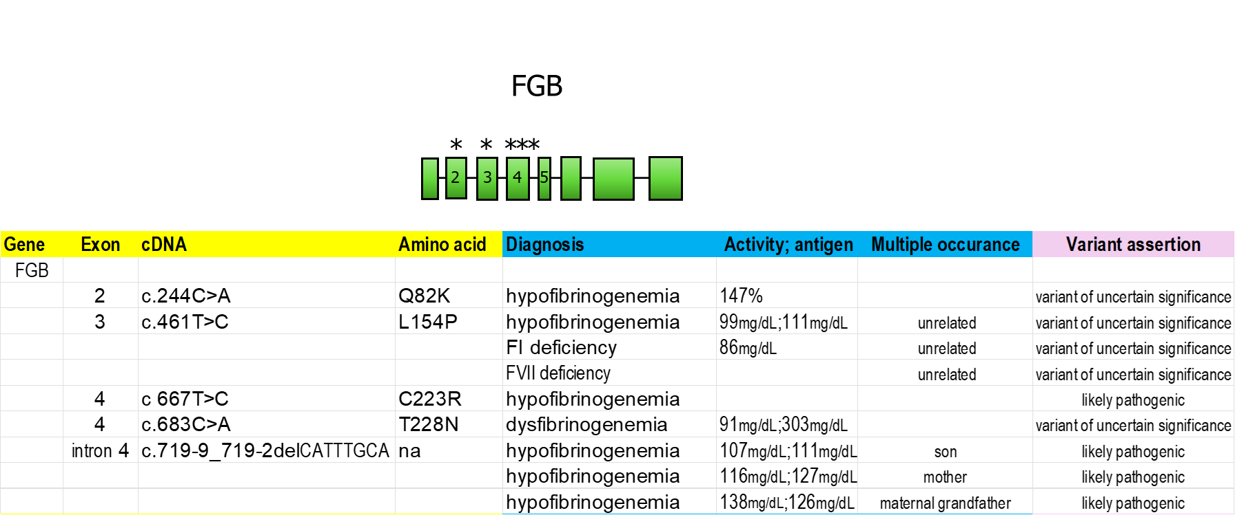
PB1341
Novel Variants in Fibrinogen Genes using a Customized 31-Gene Next-Generation Sequencing Panel
D. Nugent^{1,2}, S. Williams², C. Ashburner¹, N. Crook¹, M. Chandler³, T. Singleton^{3,4}, S. Acharya⁵ and A. Shapiro⁶
1 Center for Inherited Blood Disorders, Orange, CA, United States; 2 Hematology Advanced Diagnostic Laboratory, CHOC Children’s Hospital and UC Irvine, Orange, CA, United States; 3 American Thrombosis and Hemostasis Network, Hickory, NC, United States; 4 Ochsner Clinic Foundation, New Orleans, LA, United States; 5 Northwell Health, Cohen Children’s Medical Center, New Hyde Park, NY, United States; 6 Indiana Hemophilia & Thrombosis Center, Indianapolis, IN, United States
Introduction
The United States’ population of ∼340 million individuals is comprised of highly diverse racial and ethnic backgrounds. The incidence of ultra-rare bleeding disorders, like congenital fibrinogen abnormalities, viz. afibrinogenemia, hypofibrinogenemia, and dysfibrinogenemia, is unknown, but critically important to understand the need for specialized health care services, genetic counseling, and appropriate medical care.
Results
Structure of fibrinogen. The Aα-chains are blue, the Bβ-chains are green, and the Gγ-chains are red. (From Medved L, Weisel JW. Recommendations for nomenclature on fibrinogen and fibrin. J Thromb Haemost 2009;7:355-359.)
Novel Fibrinogen Gene Variants Found in ATHN10 Cohort
AIM
To better understand the nature and frequency of ultra-rare bleeding disorders in the US, the American Thrombosis and Hemostasis Network (ATHN) initiated ATHN 10, a collaborative effort within its network of 140 affiliated treatment centers, to perform whole gene sequencing and collection of detailed phenotypic data on enrolled patients with an identified ultra-rare bleeding disorders.
MethodS
Individuals with an established ultra-rare bleeding disorder (1300) receiving care at an HTC provided informed consent for enrollment, data collection, and genetic testing.
A single EDTA tube of blood was collected from each participant and DNA was isolated from blood samples collected. Next-Generation Sequencing (NGS) was performed on a NextSeq instrument (Illumina) to a read depth of >50 by PacificDx. Whole gene sequencing (exons, introns, and 1500 nucleotides both up and down stream) for 31 genes (including Tissue Factor) known to cause the ultra-rare factor deficiency, platelet dysfunction, thrombocytopenia, and thrombophilia diagnoses included in the project was performed for each participant. This NGS panel captured not only missense variants but was also highly effective in detecting large deletions, splice site variants, copy number variants, and early stop codon mutations.
Disease Demographics:
9% of total participants (118/1300) had a primary diagnosis of a Fibrinogen-related gene (F1) disorder.
      9% afibrinogenemia (FGA 50%, FGB 20%, FGG 30%)
      54% hypofibrinogenemia (FGA 15%, FGB 34%, FGG 44%, none 6%)
      31% dysfibrinogenemia (FGA 54%, FGB 3%, FGG 35%, none 8%)
      2.5% hypodysfibrinogenemia (FGG 100%)
      3.5% FI related (FGA 75%, FGB 25%)
3.6% of total participants had a different primary diagnosis but were incidentally found to have variants in one of the fibrinogen genes.
24% of participants with a diagnosis of F1 disorder had a novel variant.
* Approximate variant locations.
Conclusions
By leveraging the infrastructure at ATHN-affiliated HTCs and the laboratory services at the Center for Inherited Blood Disorders (CIBD)/Hematology Advanced Diagnostic Laboratory (CAP/CLIA Certified), the ATHN 10 project reduced the barriers associated with genetic testing and has expanded knowledge of the incidence of new pathogenic variants at reduced cost, allowing HTCs to provide more specific care and genetic counseling. In addition, whole gene sequencing has confirmed the role of certain genetic hot spots in clotting factor genes as well as the role of splice site variants in determining factor activity levels and bleeding phenotypic variance. This information not only helps patients and physicians, but also provides researchers with valuable resources to further our understanding of the pathophysiology of fibrinogen.
Acknowledgements
Thank you to ATHN, Indiana Hemophilia & Thrombosis Center, Center for Inherited Blood Disorders and Novo Nordisk for funding this project. Thank you to all HTCs that have enrolled participants in this project and the patients who have allowed us to collect these specimens and data. Thank you to Jeff Buzby PhD, Hilary Summer Markoe, and Shelby Domino for their work on creating this poster.

