Slide 1
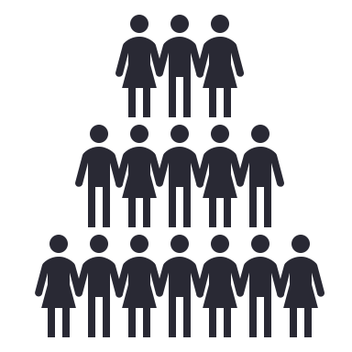



Unveiling the Unmet Needs in People with Glanzmann Thrombasthenia: Insights from the ATHN Transcends: GT Module Natural History Study
Divyaswathi Citla-Sridhar¹; Tammuella Chrisentery-Singleton^{2,3}; Jigar Amin⁴; Andrew Law⁴; Sanjay Ahuja⁵; Michael Recht^{6,7}; Jonathan Schwartz²; Meera Chitlur⁸
¹University of Arkansas for Medical Sciences, Little Rock, AR, USA; ²American Thrombosis and Hemostasis Network, Hickory, NC, USA; ³Ochsner Clinic Foundation, New Orleans, LA, USA; ⁴Hemab Therapeutics, Copenhagen, Denmark; ⁵Innovative Hematology, Indiana Hemophilia & Thrombosis Center, Indianapolis, IN, USA; ⁶National Bleeding Disorders Foundation, New York, NY, USA; ⁷Yale School of Medicine, New Haven, CT, USA; ⁸Central Michigan University, Children’s Hospital of Michigan, Detroit, MI, USA
BACKGROUND
INTERIM RESULTS
Glanzmann Thrombasthenia (GT)
Severe inheritable bleeding disorder affecting platelet function
Characterized by frequent, unpredictable bleeding events
Significant treatment challenges with limited options
Inadequate data on effective prophylaxis strategies
High risk for persistent bleeding, heavy menstrual bleeding, iron deficiency anemia, and reduced quality of life
7SVG
Characterize bleeding frequency (ABR = Annualized Bleed Rate/ATBR = Annualized Treated Bleed Rate), healthcare utilization, treatment patterns, treatment efficacy, patient-reported outcomes, and real-world effectiveness of current GT therapies
Interim Analysis: 34 participants
Demographics: 22 females (65%), 12 males (35%)
Age range: 3-77 years (median: 24 years)
Median follow-up duration: 85 days (range: 15–97 days)
Study Population
Locations of Treated and Untreated Bleeds
OBJECTIVES
Significant Bleeding Burden
Treated Bleed Events (n=87)
Untreated Bleed Events (n=71)
METHODS
34
participants
158 bleeding events
55% required treatment
ATHN Transcends: Natural History Cohort Study of Safety, Effectiveness, and Practice of Treatment in People with Non-Neoplastic Hematologic Disorders
High Frequency of Bleeding Events
Multi-institutional, observational cohort study of people affected by bleeding and clotting disorders sponsored by the American Thrombosis and Hemostasis Network (ATHN)
ABR: 72.0
Annualized Bleed Rate (Mean)
ABR >10: 56%
Severe Bleeding Burden: 19 of 34 participants
SUMMARY
ATHN Transcends Cohorts
GT is a severe, underrecognized bleeding disorder characterized by frequent bleeding episodes (ABRs) that regularly require pharmacological interventions (ATBRs)
In one participant, bleeding burden persists even with off-label recombinant Factor VIIa prophylaxis, which in turn creates a larger burden due to IV access
Menstruating individuals face additional bleeding burden
Lack of approved, effective prophylaxis underscores the urgent need for tailored therapeutic strategies
Ongoing research and expanding therapeutic options are essential to improve outcomes in people with GT
Non-Neoplastic Hematologic Conditions
Bleeding NOS
Von Willebrand Disease
Hemophilia
Thrombosis/ Thrombo-philia
Rare Blood Disorders
Congenital Platelet Disorders
ATBR: 51.9
Annualized Treated
Bleeding Rate (Mean)
1 participant reported breakthrough ABR of 30.4 and ATBR of 26.1 despite off-label recombinant factor VIIa prophylaxis
GT Module
Glanzmann Thrombasthenia (GT) Module
Module within Congenital Platelet Disorders Cohort
Longitudinal, observational cohort study at US ATHN-affiliated centers, with an international sub-cohort
Aims to enroll 60 participants, followed for ≥18 months with a 3-month daily bleed diary to document bleeding events and treatment uses, as applicable
Heavy Menstrual Bleeding Events over 9 months in 3 participants, with durations ranging from 6 to 22 days, all requiring clinical intervention with Recombinant Factor VIIa, hormonal therapy, or antifibrinolytics. One event required an additional platelet transfusion.
6
ISTH 2025, June 21-28, 2025 — Abstract ID #PB1594

