Slide 1
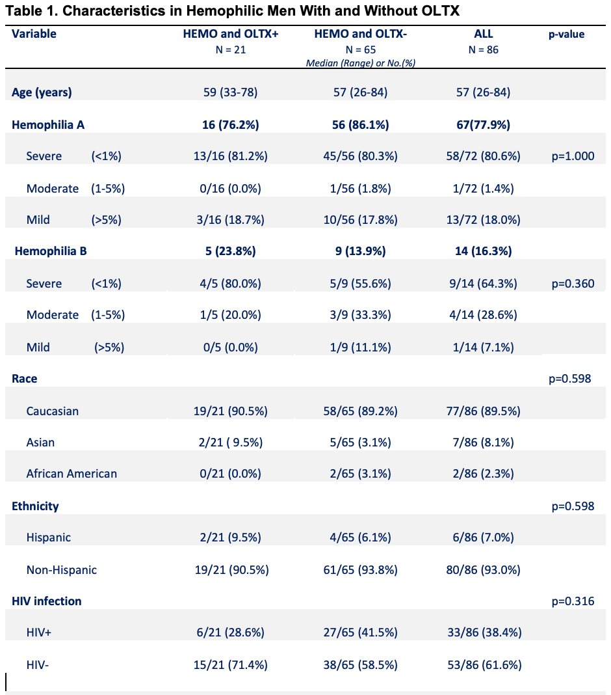
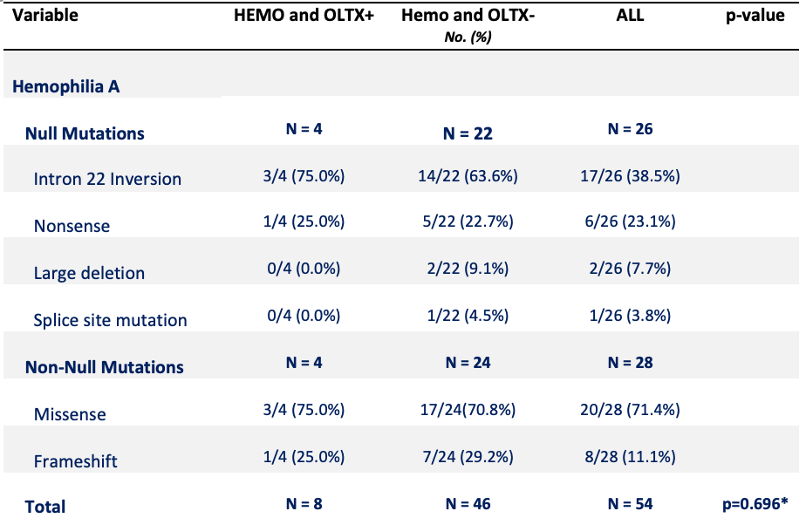
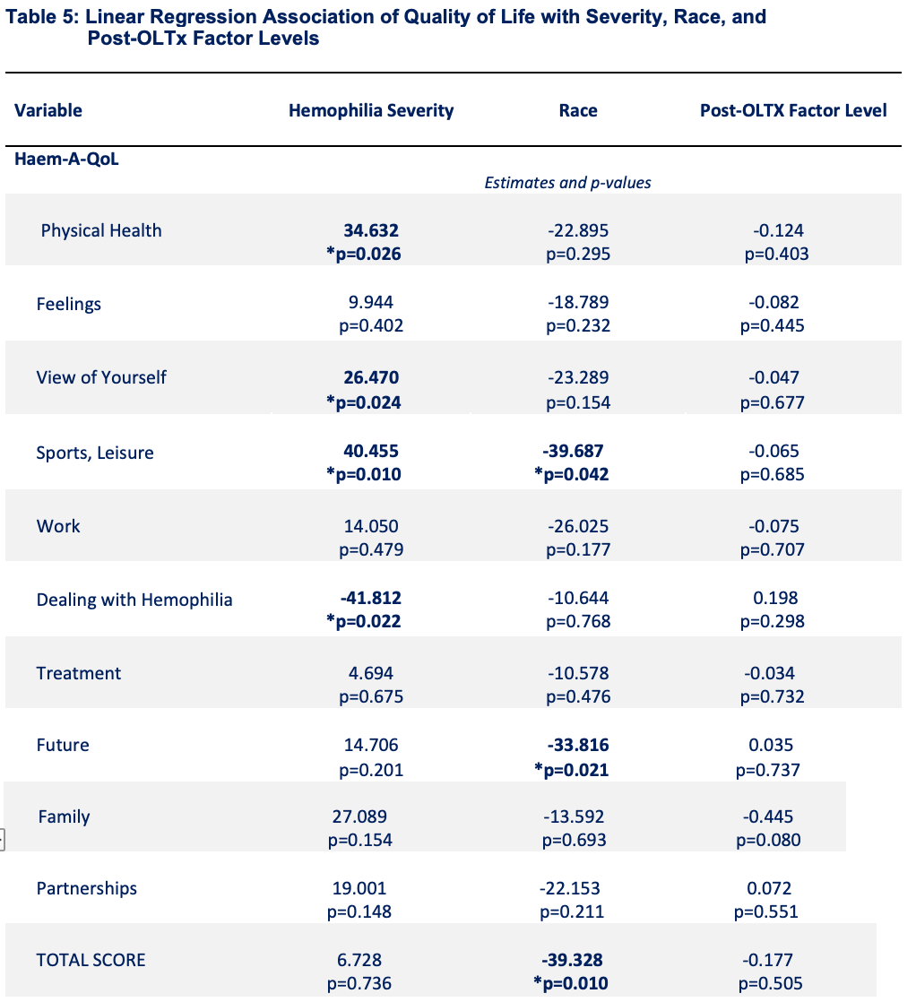
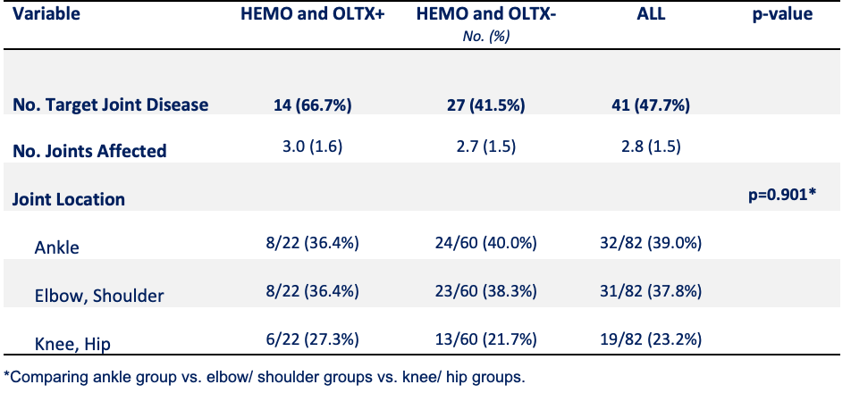
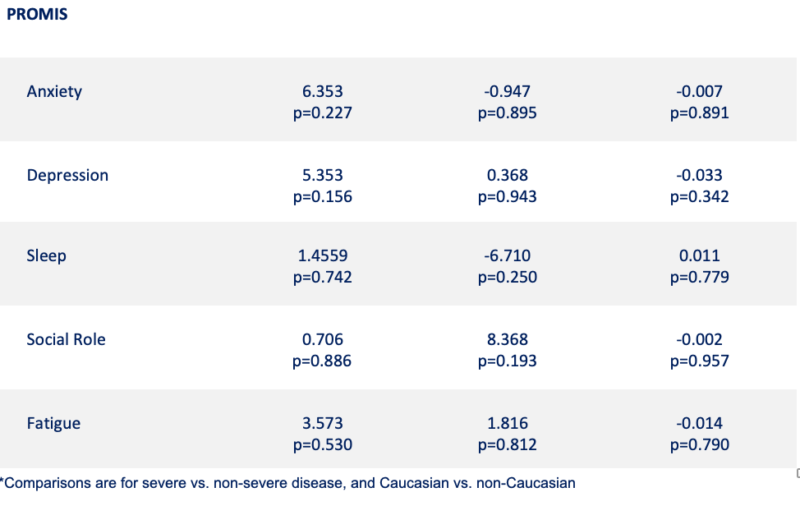
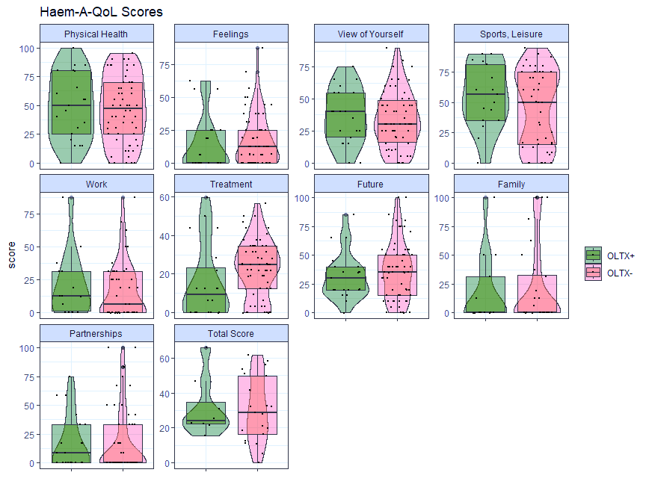
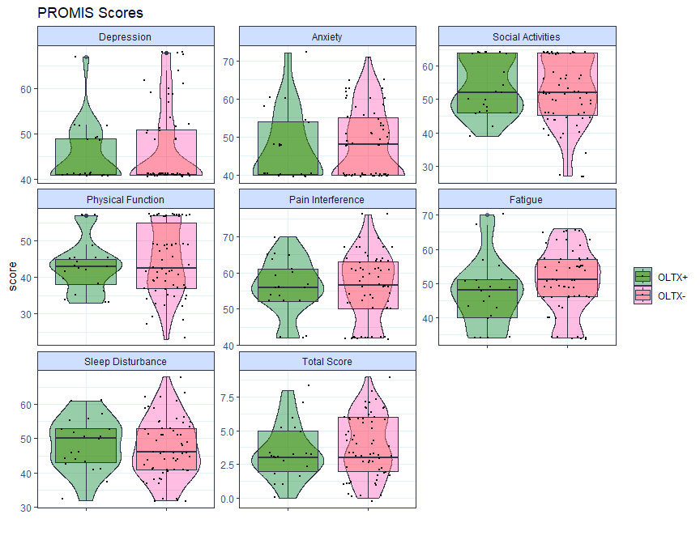
ATHN11: Observational Study of Long-term Outcomes of Liver Transplantation
M. RAGNI,¹ B. HU², J. CALLIS,² M. MANUEL,² J. SANTOS,² K. FRIEDMAN,³ P. KOUIDES,⁴ P. KURIAKOSE,⁵ A. LEAVITT,⁶ M. LIM,⁷ N. MACHIN,¹ M. RECHT,^{2 ,8}J. SCHWARTZ²
¹ University of Pittsburgh PA and Hemophilia Center Western PA , ² American Thrombosis Hemostasis Network, Rochester NY,^{, 3} Versiti Blood Research Institute, Milwaukee WII,
⁴ Rochester General Hospital, Rochester NY, ⁵ Wayne State University, Detroit MI, ⁶ University of California San Francisco, ⁷ University of Utah, Salt Lake City UT, ⁸Yale University , New Haven CT
Introduction
RESULTS
CONCLUSIONS
As gene therapy (GT) is becoming a reality for hemophilia A and B (HA, HB), little is known about the life-impact of long-term factor correction. As few data exist and recognizing the analogy to liver transplantation (OLTX), we identified OLTX+ and OLTX- in the ATHN Registry to compare post-OLTX FVIII and IX on patient-reported outcomes (PRO) and quality of life (QoL), assessed by Haem-A-QoL and PROMIS-29.
ATHN-11 is an observational study of long-term outcomes of hemophilia liver transplantation in recipients. The study was
conducted by the American Thrombosis and Hemostasis Network (ATHN) at 10 Hemophilia Treatment Centers (HTCs).
Of 86 HA or HB cared for at 10 HTCs, 21 (24.4%) OLTX+ and 65 (75.6%) OLTX- were identified. OLTX+ did not differ from OLTX- by age, by race, proportion with hemophilia A or B, disease severity, race, ethnicity, or proportion with HIV infection.
The median post-OLTX FVIII levels, 0.63 IU/dL were lower than post-OLTX factor IX level, 0.91 IU/dL. QoL by Haem-A-QoL and PROMIS did not differ between groups, nor did target joint disease, nor did type mutation, “null” vs non-null mutations.
After OLTX, there were significantly lower scores for “dealing with hemophilia” (p=0.022), and higher scores for “sports and leisure” (p=0.010) and ”view of yourself” (p=0.024) in those with severe disease, than in non-severe subjects.
After OLTX, QoL appears similar between OLTX+ and OLTX- by Haem-A-QoL & PROMIS. QoL improved in those with severe disease in sports/leisure (p=0.010), dealing with hemophilia (p=0.022), and view of yourself (p=0.024)). QoL was reduced among non-White in sports/leisure (p=0.042) and in future in the latter two domains.
Table 1: Demographics OLTX+ & OLTX- Table 2: Mutations in OLTX+ & OLTX- TABLE 3: QoL: severity, race, post-VIII,IX
REFERENCES
1. Isfordink CJ, et al. Liver-related complications before and after successful treatment of chronic hepatitis C virus infection in people with inherited bleeding disorders. Haemophilia. 2023;29:106.
2. Ragni MV, et al. Liver transplant outcomes in HIV-infected hemophilic men. Haemophilia. 2013;19:134.
3. Ragni MV, et al. Hemophilia liver transplant observational study (HOTS). Liver Transplant. 2017;6:762.
4. von Mackensen S,et al. Measurement properties of the Haem-A-QoL in hemophilia clinical trials. Haemophilia. 2017;23:383.
5. von Mackensen S, et al. Determining meaningful health-related quality-of-life improvement in persons with HJaemophilia A using the Haem-A-Qol for Adults. Haemophilia. 2020;26:1019.
6. Cella D, et al. PROMIS(R) adult health profiles: efficient short-form measures of seven health domains. Value Health. 2019;22:537.
7. van Balen EC, et al. Validation of PROMIS profile-29 in adults with hemophilia in the Netherlands. JTH 2021;19:2687.
AIM
To compare hemophilic men undergoing liver transplantation (OLTX+) and non-transplanted controls (OLTX-), by age, race, type & severity of hemophilia, joint disease, gene sequence data, and QoL by Haem-A-QoL, PROMIS, and
HOT Questionnaire, as a yardstick by which to assess QoL in gene therapy recipients.
Table 4. target joint disease
METHOD
OLTX+ subjects were compared with OLTX- by age, race, proportion with hemophilia A , hemophilia B, type, proportion with mild, moderate, or severe disease, genetic mutation, HIV status, and joint disease (present, no. target joints).
OLTX status: Transplant status was compared by presence of joint disease, genetic mutation, and QoL. The latter was assessed by Haem-A-QoL scores (physical health, feelings, future health) and PROMIS score (physical function).
QoL scores: QoL was compared with hemophilia type and severity, history of target joint disease, post-transplant factor VIII or IX levels, HIV status, and genotype.
Statistics: Continuous data were assessed by student’s t test, and discrete data by chi-square analysis or Fisher’s exact test, with significance set at <0.05.
Figure 1. Haem-A-qol Scores in OLTx+ and OLTX- FIGURE 2. PROMIS SCORES in OLTX+ and OLTX-
ACKNOWLEDGEMENTS
Funding Agencies supporting this study:
BioMarin
State Support of Hemophilia Center of Western PA, SAP #4100079797
HRSA Federal Hemophilia Treatment Centers, Grant H30MC24050-04-00.
CONTACT INFORMATION
Principal Investigator:
Margaret V. Ragni, MD, MPH ragni@pitt.edu
Haem-A-QoLscores in hemophilia subjects undergoing liver transplantation, OLTX+ (green), and in controls who did not undergo liver transplantation, OLTX- (pink).
The PROMIS-29 scores in hemophilia subjects undergoing liver transplantation, OLTX+ (green), and in controls who did not undergo liver transplantation, OLTX- (pink).

